Slide 1




KEY LOGGER
Unlocking Insights, Safeguarding Security:
The Power of Key Logging

Slide 2


TOPICS
Introduction
Background
Algorithm
System Design
Technologies Used
Results and Output
Conclusion

Slide 3


INTRODUCTION
The project presented in this report focuses on the development of a keylogger
application designed with ethical purposes in mind. By definition, an ethical
keylogger is a tool used by security professionals to investigate and assess the
security posture of computer systems, networks, or applications, with the explicit
permission of the system owner. It aims to assist in identifying vulnerabilities and
enhancing security measures rather than engaging in malicious activities.
Back to Topic Page

Slide 4
BACKGROUND
The development of an ethical keylogger holds significant relevance in today's
digital landscape due to the increasing prevalence of cyber threats and the need
for robust security measures. By utilizing a keylogger for ethical purposes,
security professionals can proactively identify vulnerabilities, protect sensitive
information, and enhance the overall security posture of computer systems,
networks, and applications.
Back to Topic Page

Slide 5
If the bank has thousands of active
online banking customers and each customer performs an average of 10 keystrokes per minute while accessing their accounts. Assuming the keylogger runs for a duration of one hour during the assessment
Real-life example
10 keystrokes/minute * 60 minutes/hour * 1 hour = 600 keystrokes per customer
Back to Agenda Page

Slide 6
If the bank has 10,000 active online banking customers, the keylogger would
capture 60,00,000 keystrokes during that one-hour period:
Real-life example
600 keystrokes/customer * 10,000 customers = 60,00,000 keystrokes
Back to Agenda Page

Slide 7
REAL - LIFE EXAMPLE
By analyzing these logged keystrokes, security professionals can detect unusual
patterns or suspicious activities indicative of fraudulent behavior. For example,
they may identify instances where an account holder's keystrokes deviate
significantly from their typical usage, indicating a potential hijacked account or
unauthorized access.
Back to Topic Page

Slide 8
ALGORITHM
1. Import necessary libraries for various functionalities such as email handling,
information gathering, clipboard access, keystroke recording, time
management, encryption, screenshot capturing, and file operations.
2. Set up variables for file paths, email credentials, system information, and
other necessary parameters.
3. Send an initial email with the keylogger's log file to a specified email address.
4. Gather system information such as hostname, IP address, processor
details, and operating system information.
5. Capture the clipboard content.
6. Capture screenshots of the screen.
Back to Topic Page

Slide 9
ALGORITHM
7. Set up a loop to capture keystrokes using the pynput library. The keystrokes
are logged into a file.
8. Monitor the time and stop capturing keystrokes after a specified time interval
or a specified number of iterations.
9. Save the captured keystrokes, screenshots, and clipboard content to
separate files.
10. Encrypt the captured files using the cryptography library and a generated
encryption key.
11. Send encrypted files via email to the specified recipient.
12. Delete the captured files to clean up tracks.
Back to Topic Page

Slide 10

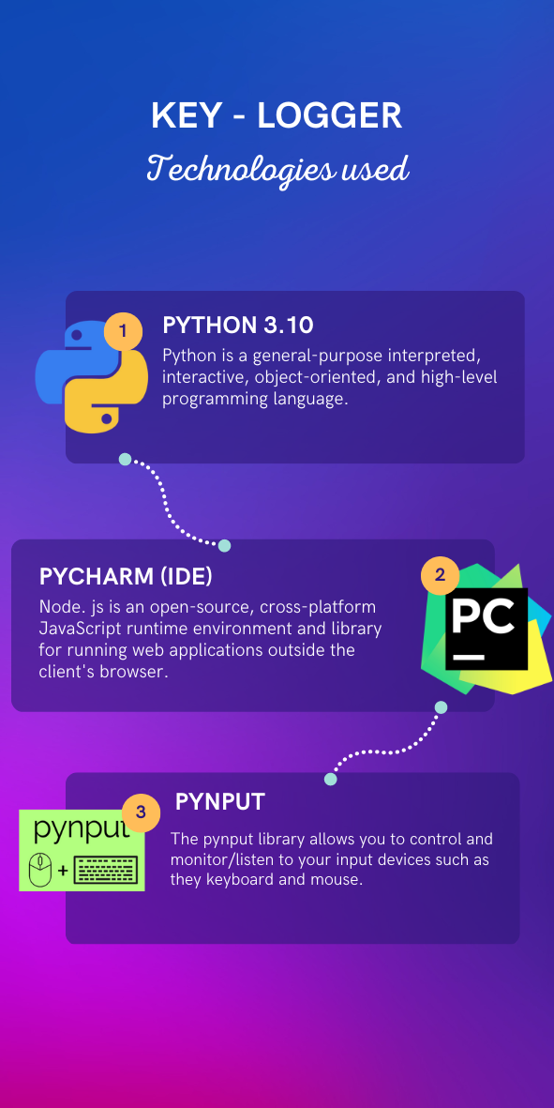


Technology
Used

Slide 11
SYSTEM DESIGN
1. The system consists of the following components:
2. Email Handling: The code utilizes the smtplib library to send emails with log
files as attachments. The email credentials, recipient address, and email
content are configured within the code.
3. Information Gathering: The code uses various libraries and functions to
gather system information, such as hostname, IP addresses, processor
details, and operating system information.
4. Clipboard Access: The win32clipboard library allows the code to access and
capture the content of the clipboard.
5. Keystroke Recording: The pynput library is used to monitor and capture
keystrokes. The on_press and on_release functions handle the recording of
keystrokes and writing them to a file.
Back to Topic Page

Slide 12
SYSTEM DESIGN
6. Time Management: The code utilizes time-related functions to manage the
duration of audio recording, the time interval for capturing keystrokes, and
the overall execution time.
7. Screenshot Capturing: The PIL library (Python Imaging Library) is used to
capture screenshots of the screen. The captured screenshots are saved as
image files.
Back to Topic Page

Slide 13
SYSTEM DESIGN
8. Encryption: The cryptography library is used to encrypt the captured files
using the Fernet symmetric encryption algorithm. An encryption key is
generated and used to encrypt the files.
9. File Operations: The code performs various file operations, such as writing
captured information to files, deleting captured files, and encrypting files.
10. Flow Control: The code utilizes loops and conditionals to control the flow of
execution, including capturing keystrokes, monitoring time, and stopping the
execution after a specified interval or number of iterations.
Back to Topic Page

Slide 14
RESULTS
The keylogger project presented above successfully implements various
functionalities, including keystroke logging, system information gathering, clipboard
access, screenshot capturing, file encryption, and email sending.
When executed, the code effectively captures and logs keystrokes,
collects system information, records audio, captures screenshots, and encrypts
the collected data.
The encrypted data is then sent via email to a specified recipient.
Back to Topic Page

Slide 15

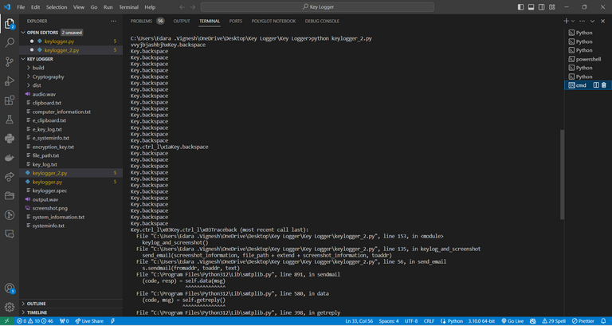
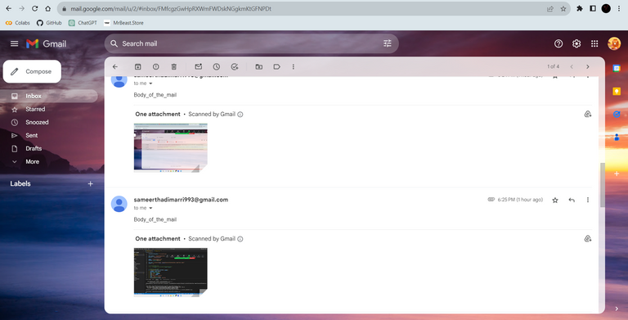

OUTPUT
KeyLogger
Emails
getting stored in another
file
All log files are sent to
us through mails
Back to Topic Page

Slide 16
CONCLUSION
The keylogger project provides a practical demonstration of how keyloggers can
be implemented for ethical purposes. The project showcases the potential
applications of keyloggers in enhancing security measures and identifying
vulnerabilities in computer systems. It highlights the importance of proactive
monitoring and analysis of user activities to prevent fraudulent activities,
unauthorized access, and potential data breaches.
Back to Topic Page

Slide 17




THANK
YOU

